Slide 1
THANK YOU FOR DOWNLOADING
Hope it helps you with your presentations!
In case the embedded fonts don’t work, here are the download links:
JetBrains Mono
https://fonts.google.com/specimen/JetBrains+Mono
Holla Summer
https://freedesignresources.net/holla-summer-script-font/

Slide 2

LOONA
Presentation

Slide 3



BOYCOTT BLOCKBERRY AIRLINES // BOARDING PASS
LOONAVERSE
LOONAVERSE
FLIGHT
DATE
NAME
OT12
10.JAN.2023
@DSTORYCO
FLIGHT
DATE
OT12
10.JAN.2023
GATE
NAME
3
@DSTORYCO
BOARDING PASS

Slide 4
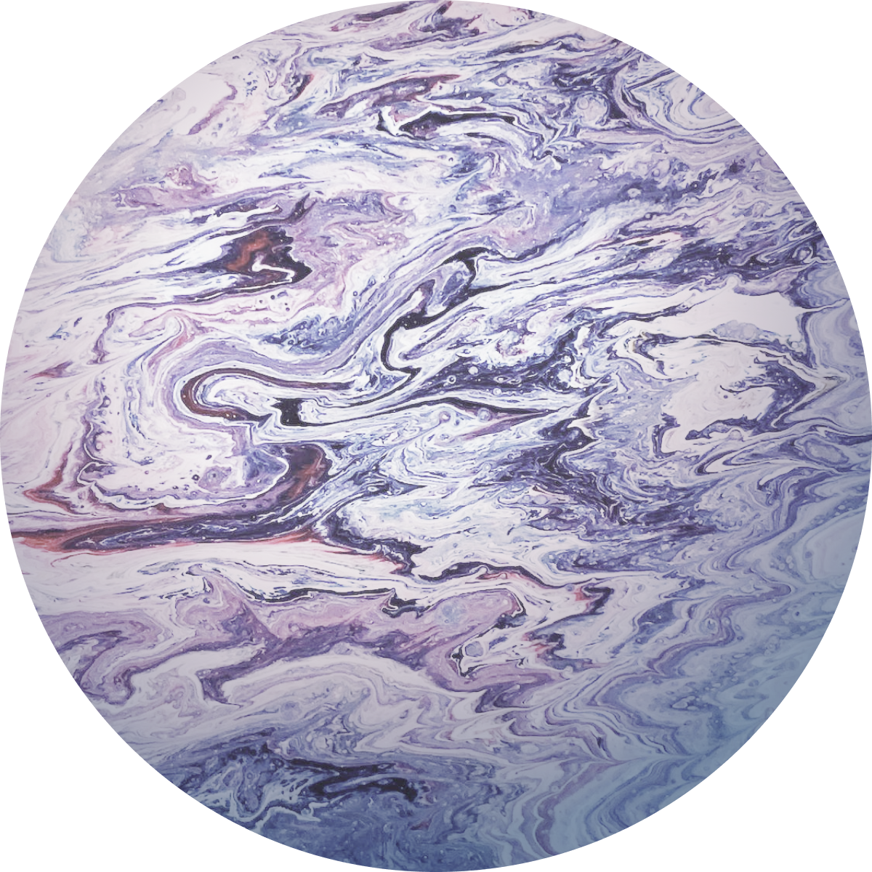
LOONAVERSE
BOYCOTT BLOCKBERRY AIRLINES // BOARDING PASS
FLIGHT
DATE
NAME
LOONAVERSE
OT12
10.JAN.2023
@DSTORYCO
FLIGHT
DATE
OT12
10.JAN.2023
BOARDING PASS
GATE
NAME
3
@DSTORYCO

Slide 5
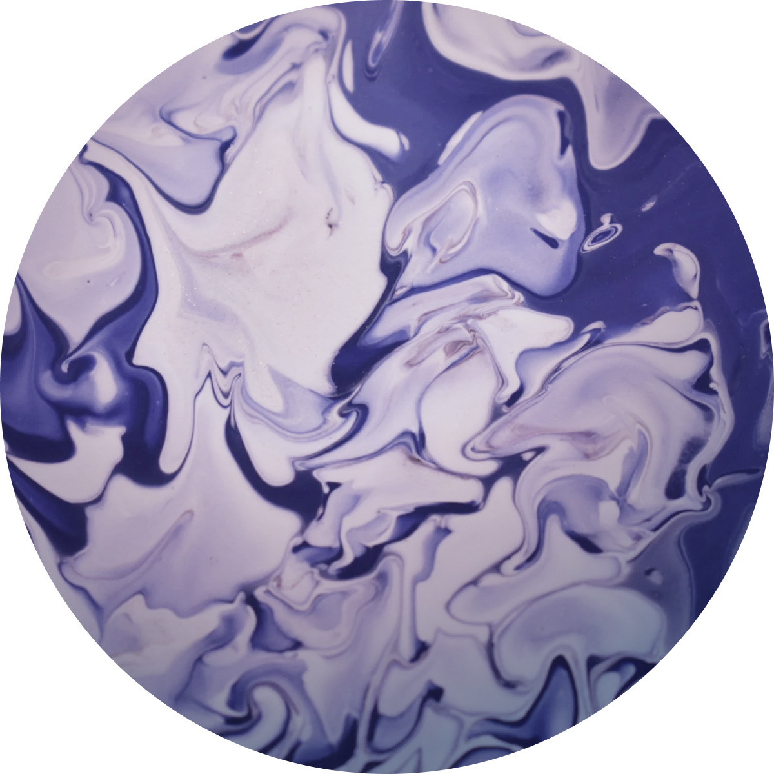

MOON
LOONAVERSE
FLIGHT
DATE
NAME
OT12
10.JAN.2023
@DSTORYCO
00
08
BOARDING PASS
The Earth’s only natural satellite.
DIAMETER
ROTATIONAL PERIOD
AXIAL TILT
3475km
655.7hrs
6.7°
BOYCOTT BLOCKBERRY AIRLINES // BOARDING PASS
LOONAVERSE
FLIGHT
DATE
OT12
10.JAN.2023
GATE
NAME
3
@DSTORYCO

Slide 6
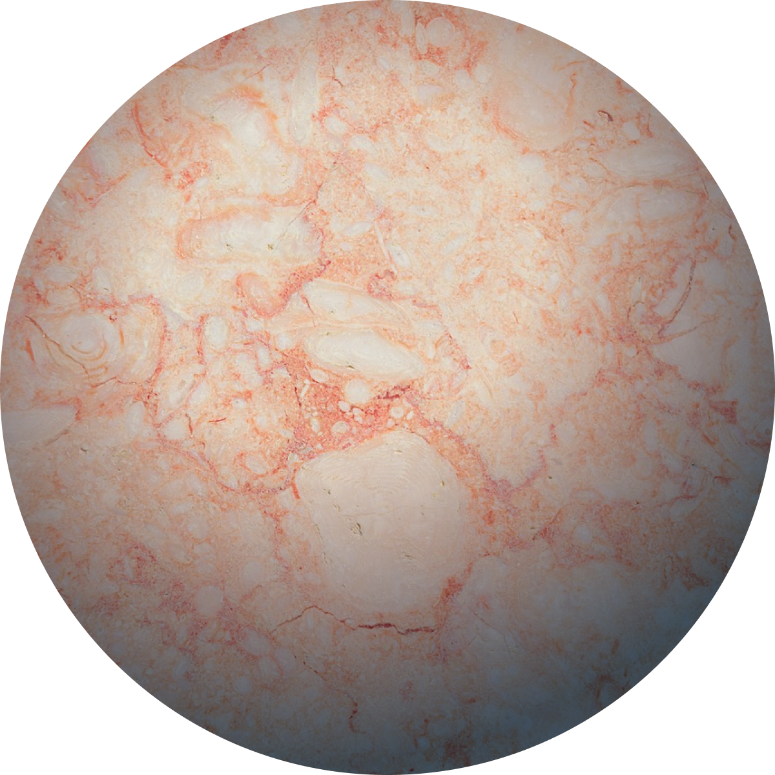
MERCURY
01
08
The smallest planet in our solar system and nearest to the Sun.
DIAMETER
ROTATIONAL PERIOD
AXIAL TILT
4879km
1407.6hrs
0.03°

Slide 7

VENUS
02
08
Sometimes called Earth’s “sister” as it’s almost as large, with a similar composition.
DIAMETER
ROTATIONAL PERIOD
AXIAL TILT
12104km
-5832hrs
177.4°

Slide 8
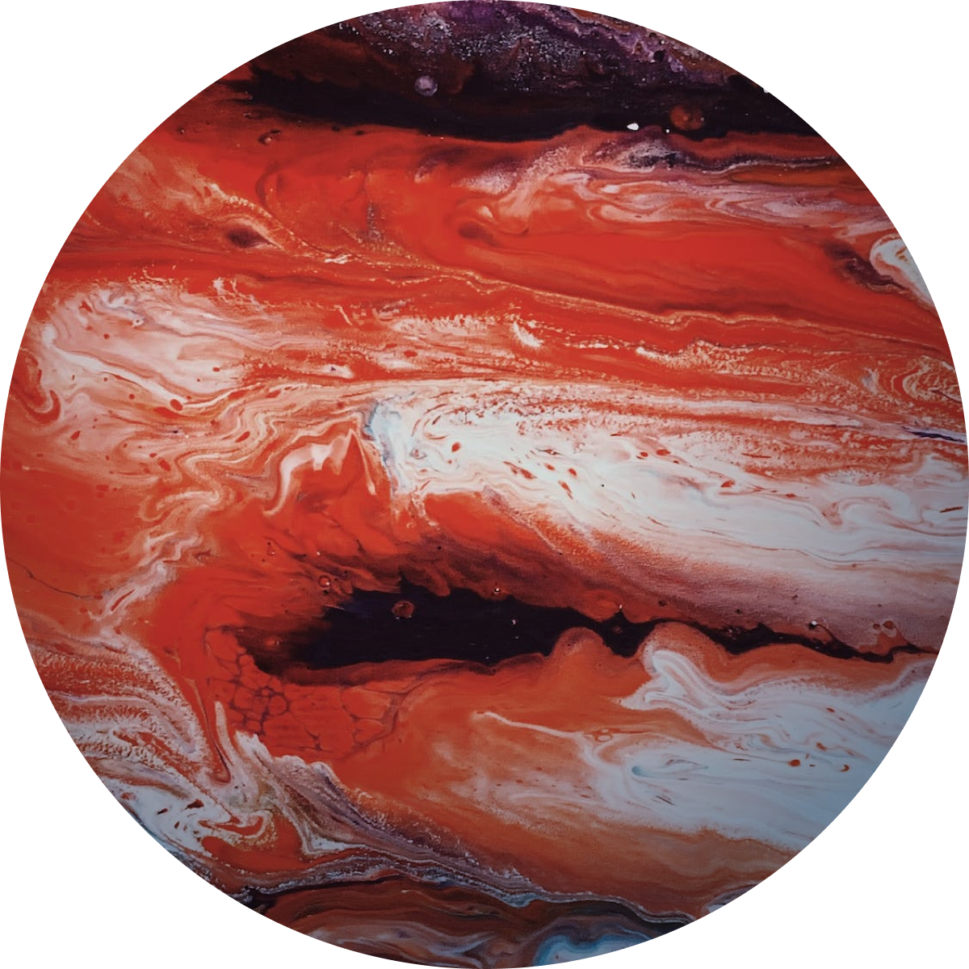
EARTH
03
08
The only place in the universe known to harbour life.
DIAMETER
ROTATIONAL PERIOD
AXIAL TILT
12756km
23.9hrs
23.5°

Slide 9
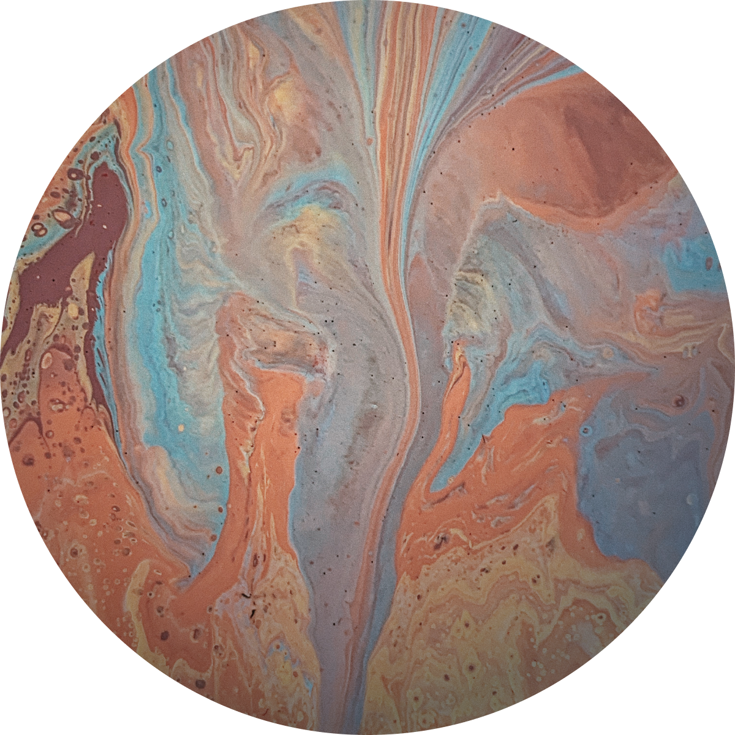
MARS
04
08
A terrestrial planet with a thin atmosphere, and has a crust composed of elements.
DIAMETER
ROTATIONAL PERIOD
AXIAL TILT
4879km
24.6hrs
25.2°

Slide 10

JUPITER
05
08
The largest planet in the Solar System.
DIAMETER
ROTATIONAL PERIOD
AXIAL TILT
140982km
9.9hrs
3.1°

Slide 11

SATURN
06
08
Only one-eighth the average density of Earth, but is over 95 times more massive.
DIAMETER
ROTATIONAL PERIOD
AXIAL TILT
120536km
10.7hrs
26.7°

Slide 12

URANUS
07
08
The coldest planetary atmosphere in the Solar System.
DIAMETER
ROTATIONAL PERIOD
AXIAL TILT
51118km
-17.2hrs
97.8°

Slide 13
NEPTUNE
08
08
Being composed primarily of gases an liquids, it has no well-defined solid surface.
DIAMETER
ROTATIONAL PERIOD
AXIAL TILT
49528km
16.1hrs
28.3°

